Slide 1
Chapter 6
Assessing the Assumptions of the Regression Model (Part 1)
Terry Dielman
Applied Regression Analysis
for Business and Economics
Checking Assumptions
Copyright © 2005 Brooks/Cole, a division of Thomson Learning, Inc.

Slide 2
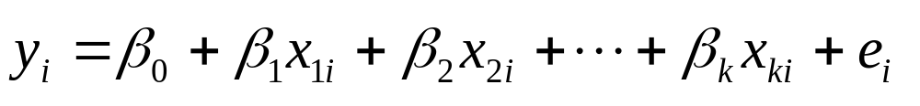
6.1 Introduction
In Chapter 4 the multiple linear regression model was presented as
Certain assumptions were made about how the errors e_{i} behaved. In this chapter we will check to see if those assumptions appear reasonable.
Checking Assumptions
Copyright © 2005 Brooks/Cole, a division of Thomson Learning, Inc.

Slide 3
6.2 Assumptions of the Multiple Linear Regression Model
We expect the average disturbance e_{i} to be zero so the regression line passes through the average value of Y.
The disturbances have constant variance σ_{e}².
The disturbances are normally distributed.
The disturbances are independent.
Checking Assumptions
Copyright © 2005 Brooks/Cole, a division of Thomson Learning, Inc.

Slide 4
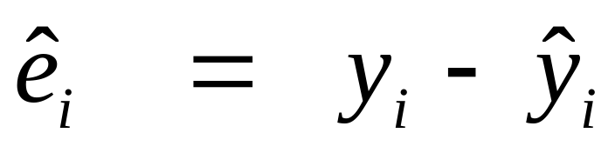
6.3 The Regression Residuals
We cannot check to see if the disturbances e_{i} behave correctly because they are unknown.
Instead, we work with their sample counterpart, the residuals
which represent the unexplained variation in the y values.
Checking Assumptions
Copyright © 2005 Brooks/Cole, a division of Thomson Learning, Inc.

Slide 5
Properties
Property 1: They will always average 0 because the least squares estimation procedure makes that happen.
Property 2: If assumptions a, b and d of Section 6.2 are true then the residuals should be randomly distributed around their mean of 0. There should be no systematic pattern in a residual plot.
Property 3: If assumptions a through d hold, the residuals should look like a random sample from a normal distribution.
Checking Assumptions
Copyright © 2005 Brooks/Cole, a division of Thomson Learning, Inc.

Slide 6
Suggested Residual Plots
Plot the residuals versus each explanatory variable.
Plot the residuals versus the predicted values.
For data collected over time or in any other sequence, plot the residuals in that sequence.
In addition, a histogram and box plot are useful for assessing normality.
Checking Assumptions
Copyright © 2005 Brooks/Cole, a division of Thomson Learning, Inc.

Slide 7
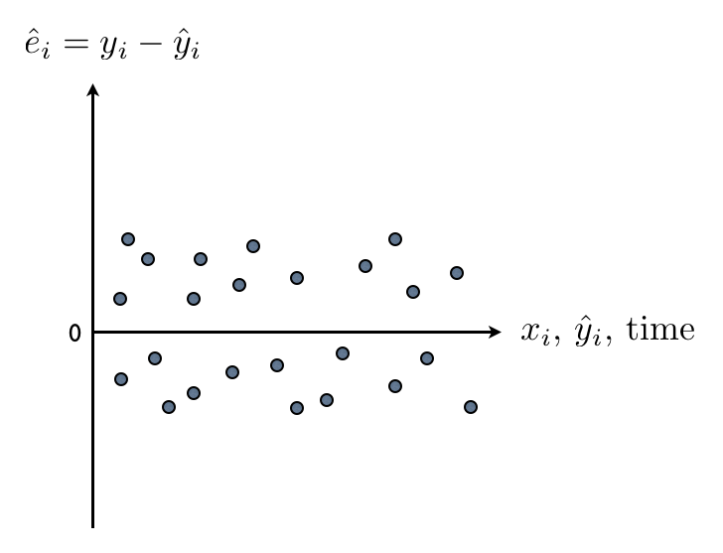
Residual Plot
No pattern around zero
The same variance
Checking Assumptions
Copyright © 2005 Brooks/Cole, a division of Thomson Learning, Inc.

Slide 8
Standardized residuals
The residuals can be standardized by dividing by their standard error.
This will not change the pattern in a plot but will affect the vertical scale.
Standardized residuals are always scaled so that most are between -2 and +2 as in a standard normal distribution.
Checking Assumptions
Copyright © 2005 Brooks/Cole, a division of Thomson Learning, Inc.

Slide 9
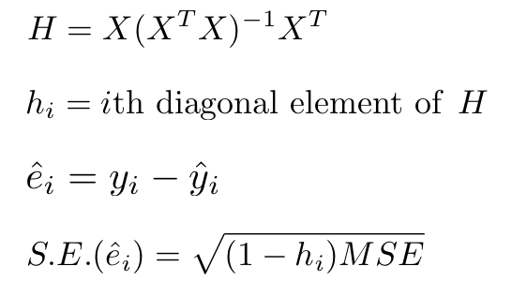
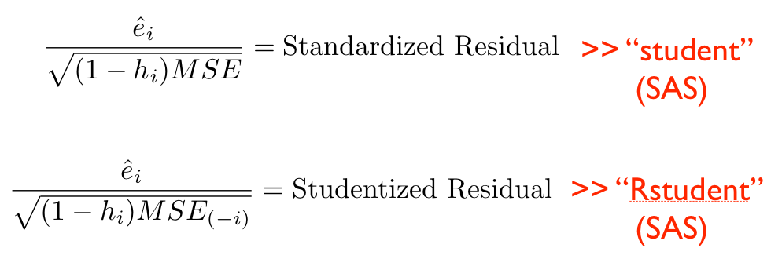
Checking Assumptions
Copyright © 2005 Brooks/Cole, a division of Thomson Learning, Inc.

Slide 10
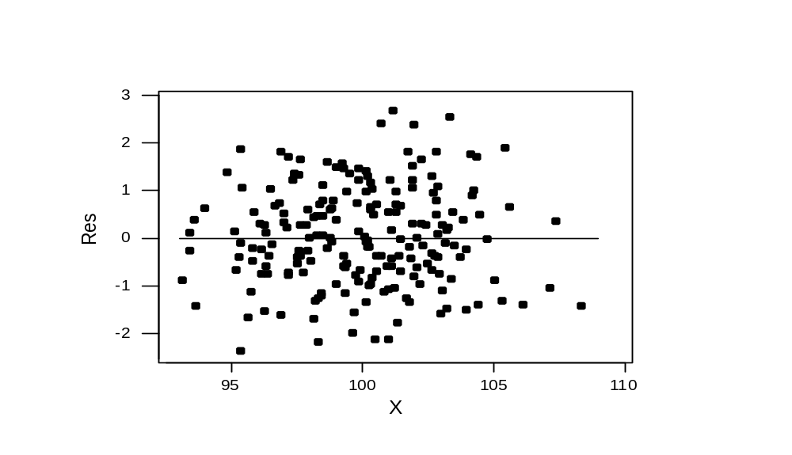
A plot meeting property 2
a. mean of 0 b. Same scatter d. No pattern with X
Checking Assumptions
Copyright © 2005 Brooks/Cole, a division of Thomson Learning, Inc.

Slide 11
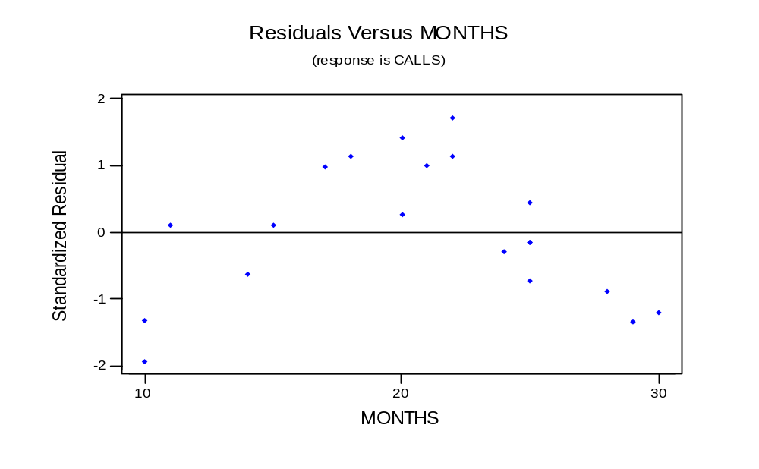
A plot showing a violation
Checking Assumptions
Copyright © 2005 Brooks/Cole, a division of Thomson Learning, Inc.

Slide 12
6.4 Checking Linearity
Although sometimes we can see evidence of nonlinearity in an X-Y scatterplot, in other cases we can only see it in a plot of the residuals versus X.
If the plot of the residuals versus an X shows any kind of pattern, it both shows a violation and a way to improve the model.
Checking Assumptions
Copyright © 2005 Brooks/Cole, a division of Thomson Learning, Inc.

Slide 13
Example 6.1: Telemarketing
n = 20 telemarketing employees
Y = average calls per day over 20 workdays
X = Months on the job
Data set TELEMARKET6
Checking Assumptions
Copyright © 2005 Brooks/Cole, a division of Thomson Learning, Inc.

Slide 14
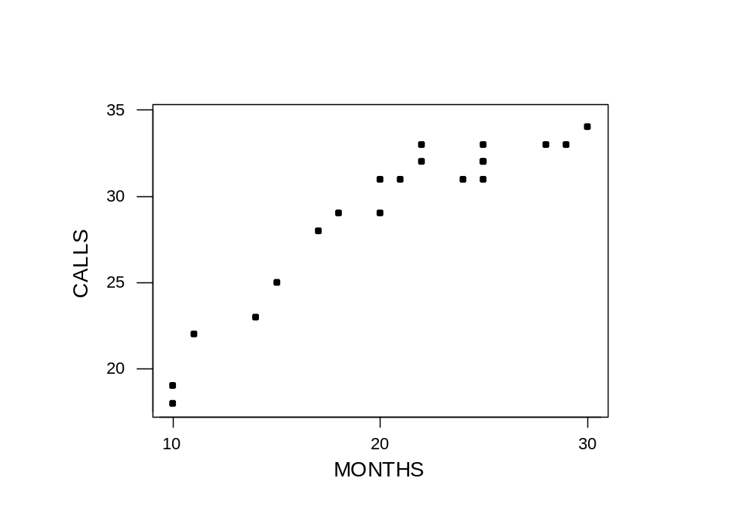
Plot of Calls versus Months
There is some curvature, but it is masked by the more obvious linearity.
Checking Assumptions
Copyright © 2005 Brooks/Cole, a division of Thomson Learning, Inc.

Slide 15
If you are not sure, fit the linear model and save the residuals
The regression equation is
CALLS = 13.7 + 0.744 MONTHS
Predictor Coef SE Coef T P
Constant 13.671 1.427 9.58 0.000
MONTHS 0.74351 0.06666 11.15 0.000
S = 1.787 R-Sq = 87.4% R-Sq(adj) = 86.7%
Analysis of Variance
Source DF SS MS F P
Regression 1 397.45 397.45 124.41 0.000
Residual Error 18 57.50 3.19
Total 19 454.95
Checking Assumptions
Copyright © 2005 Brooks/Cole, a division of Thomson Learning, Inc.

Slide 16
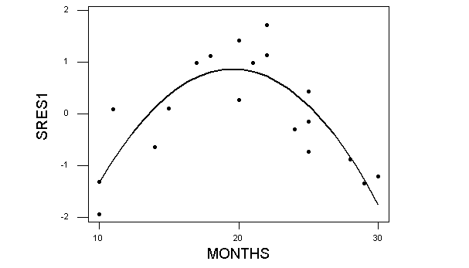
Residuals from model
With the linearity "taken out" the curvature is more obvious
Checking Assumptions
Copyright © 2005 Brooks/Cole, a division of Thomson Learning, Inc.

Slide 17
6.4.2 Tests for lack of fit
The residuals contain the variation in the sample of Y values that is not explained by the Yhat equation.
This variation can be attributed to many things, including:
  natural variation (random error)
  omitted explanatory variables
  incorrect form of model
Checking Assumptions
Copyright © 2005 Brooks/Cole, a division of Thomson Learning, Inc.

Slide 18
Lack of fit
If nonlinearity is suspected, there are tests available for lack of fit.
Minitab has two versions of this test, one requiring there to be repeated observations at the same X values.
These are on the Options submenu off the Regression menu
Checking Assumptions
Copyright © 2005 Brooks/Cole, a division of Thomson Learning, Inc.

Slide 19
The pure error lack of fit test
In the 20 observations for the telemarketing data, there are two at 10, 20 and 22 months, and four at 25 months.
These replicates allow the SSE to be decomposed into two portions, "pure error" and "lack of fit".
Checking Assumptions
Copyright © 2005 Brooks/Cole, a division of Thomson Learning, Inc.

Slide 20
The test (Lack of Fit test)
H₀: Lack of Fit = 0 (The relationship is linear)
H_{a}: Lack of Fit 0 (The relationship is not linear)
The test statistic follows an F distribution with c – k – 1 numerator df and n – c denominator df
c = number of distinct levels of X
n = 20 and there were 6 replicates so c = 14
Checking Assumptions
Copyright © 2005 Brooks/Cole, a division of Thomson Learning, Inc.

Slide 21
Minitab's output
The regression equation is
CALLS = 13.7 + 0.744 MONTHS
Predictor Coef SE Coef T P
Constant 13.671 1.427 9.58 0.000
MONTHS 0.74351 0.06666 11.15 0.000
S = 1.787 R-Sq = 87.4% R-Sq(adj) = 86.7%
Analysis of Variance
Source DF SS MS F P
Regression 1 397.45 397.45 124.41 0.000
Residual Error 18 57.50 3.19
Lack of Fit 12 52.50 4.38 5.25 0.026
Pure Error 6 5.00 0.83
Total 19 454.95
C-k-1 =14-1-1 =12
N-c =20-14 =6
H0: Lack of Fit = 0
Checking Assumptions
Copyright © 2005 Brooks/Cole, a division of Thomson Learning, Inc.

Slide 22
Test results
At a 5% level of significance, the critical value (from F_{12, 6} distribution) is 4.00.
The computed F is 5.25 is significant (p value of .026) so we conclude the relationship is not linear.
Checking Assumptions
Copyright © 2005 Brooks/Cole, a division of Thomson Learning, Inc.

Slide 23
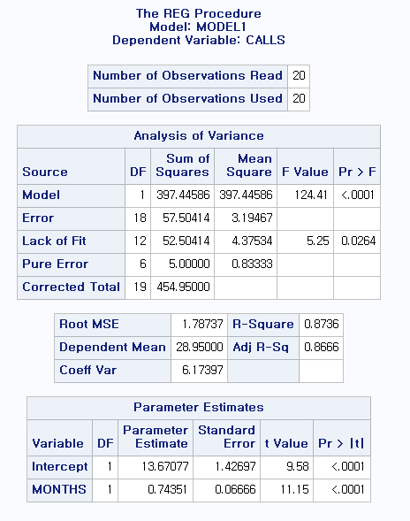
proc reg data = a; model calls = months / lackfit ; run;
H0 : Lack of Fit = 0
Reject H0 -> not linear
Copyright © 2005 Brooks/Cole, a division of Thomson Learning, Inc.

Slide 24
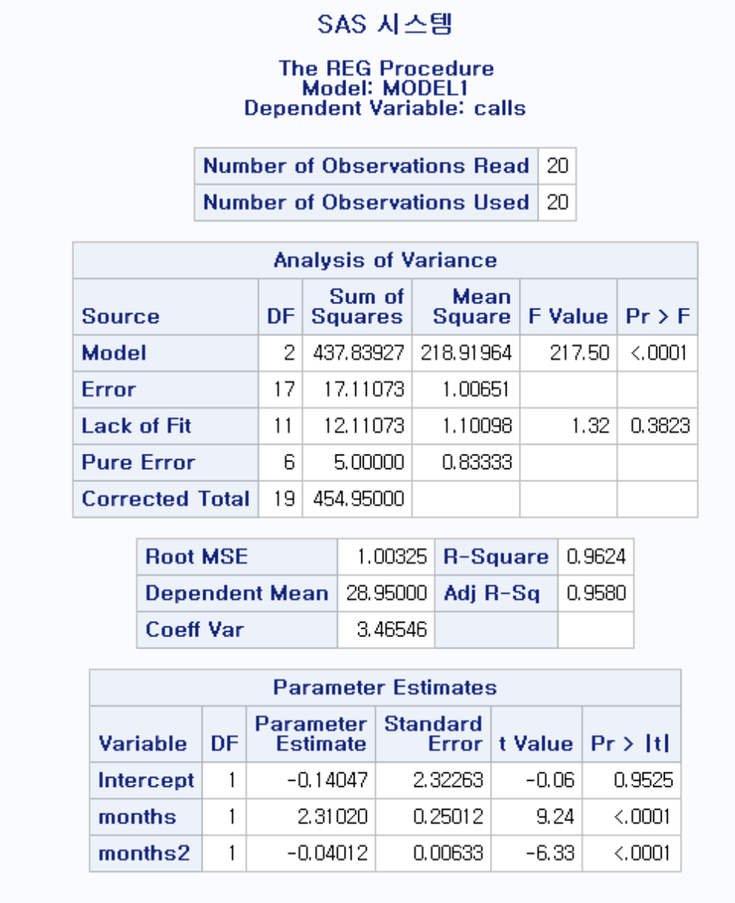
proc reg data = a; model calls = months months2 / lackfit ; run;
H0 : Lack of Fit = 0
Do not Reject H0
-> Quadratic
Copyright © 2005 Brooks/Cole, a division of Thomson Learning, Inc.

Slide 25
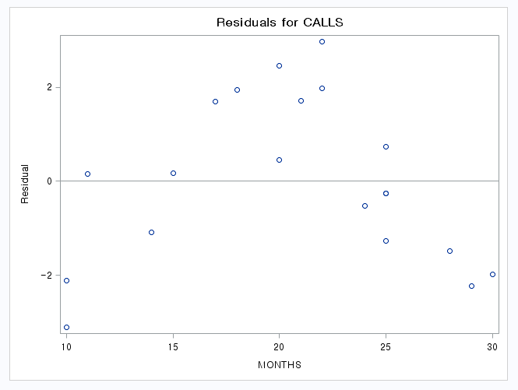
Residual plot in SAS
Need a quadratic term !!
Checking Assumptions
Copyright © 2005 Brooks/Cole, a division of Thomson Learning, Inc.

Slide 26
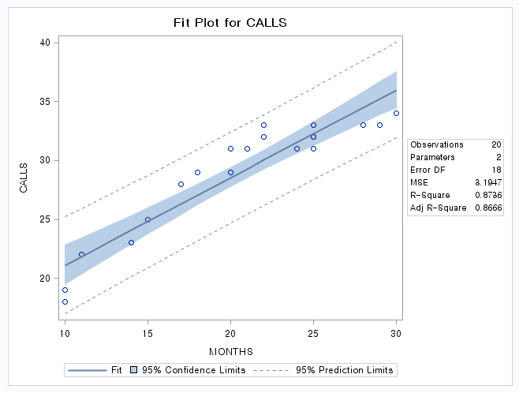
Checking Assumptions
Copyright © 2005 Brooks/Cole, a division of Thomson Learning, Inc.

Slide 27
Tests without replication
Minitab also has a series of lack of fit tests that can be applied when there is no replication.
When they are applied here, these messages appear:
The small p values suggest lack of fit.
Lack of fit test
Possible curvature in variable MONTHS (P-Value = 0.000)
Possible lack of fit at outer X-values (P-Value = 0.097)
Overall lack of fit test is significant at P = 0.000
Checking Assumptions
Copyright © 2005 Brooks/Cole, a division of Thomson Learning, Inc.

Slide 28
6.4.3 Corrections for nonlinearity
If the linearity assumption is violated, the appropriate correction is not always obvious.
Several alternative models were presented in Chapter 5.
In this case, it is not too hard to see that adding an X² term works well.
Checking Assumptions
Copyright © 2005 Brooks/Cole, a division of Thomson Learning, Inc.

Slide 29
Quadratic model
The regression equation is
CALLS = - 0.14 + 2.31 MONTHS - 0.0401 MonthSQ
Predictor Coef SE Coef T P
Constant -0.140 2.323 -0.06 0.952
MONTHS 2.3102 0.2501 9.24 0.000
MonthSQ -0.040118 0.006333 -6.33 0.000
S = 1.003 R-Sq = 96.2% R-Sq(adj) = 95.8%
Analysis of Variance
Source DF SS MS F P
Regression 2 437.84 218.92 217.50 0.000
Residual Error 17 17.11 1.01
Total 19 454.95
No evidence of lack of fit (P > 0.1)
Checking Assumptions
Copyright © 2005 Brooks/Cole, a division of Thomson Learning, Inc.

Slide 30
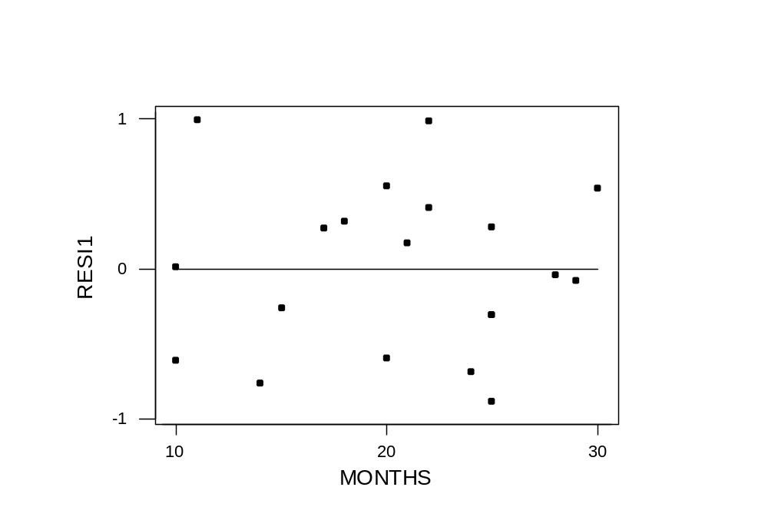
Residuals from quadratic model
No violations evident
Checking Assumptions
Copyright © 2005 Brooks/Cole, a division of Thomson Learning, Inc.

Slide 31
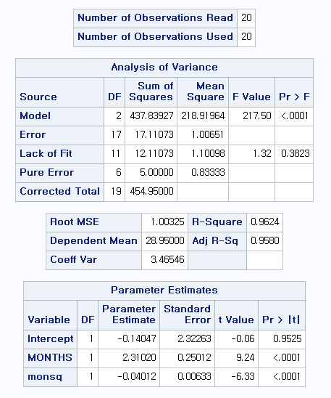
proc reg data = a; model calls = months monsq / lackfit ; run;
H0 : Lack of Fit = 0
Do not reject H0
No need cubic term !!
Checking Assumptions
Copyright © 2005 Brooks/Cole, a division of Thomson Learning, Inc.

Slide 32
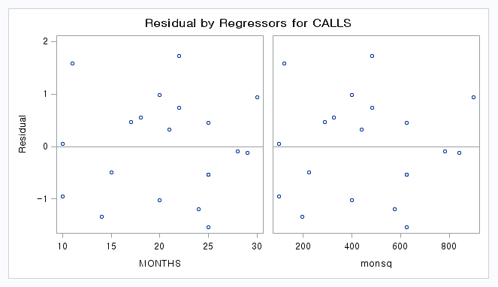
Residual Plots in SAS
No pattern !!
Checking Assumptions
Copyright © 2005 Brooks/Cole, a division of Thomson Learning, Inc.

Slide 33
6.5 Check for constant variance
Assumption b states that the errors e_{i} should have the same variance everywhere.
This implies that if residuals are plotted against an explanatory variable, the scatter should be the same at each value of the X variable.
In economic data, however, it is fairly common to see that a variable that increases in value often will also increase in scatter.
Checking Assumptions
Copyright © 2005 Brooks/Cole, a division of Thomson Learning, Inc.

Slide 34
Example 6.3 FOC Sales
n = 265 months of sales data for a fibre-optic company
Y = Sales
X= Mon ( 1 thru 265)
Data set FOCSALES6
Checking Assumptions
Copyright © 2005 Brooks/Cole, a division of Thomson Learning, Inc.

Slide 35
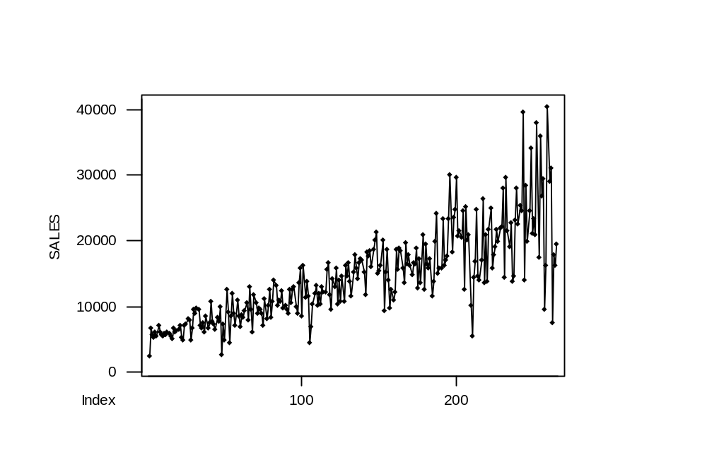
Data over time
Note: This uses Minitab’s Time Series Plot
Checking Assumptions
Copyright © 2005 Brooks/Cole, a division of Thomson Learning, Inc.

Slide 36
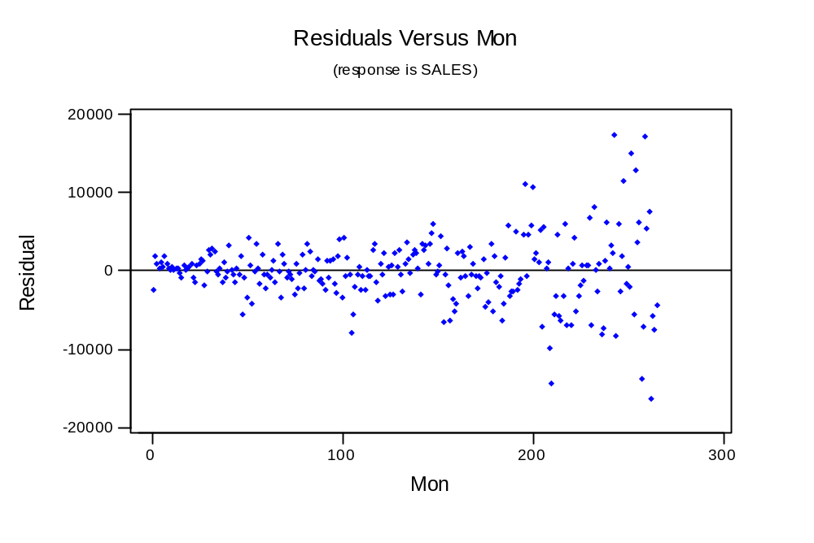
Residual plot
Checking Assumptions
Copyright © 2005 Brooks/Cole, a division of Thomson Learning, Inc.

Slide 37
Implications
When the errors e_{i} do not have a constant variance, the usual statistical properties of the least squares estimates may not hold.
In particular, the hypothesis tests on the model may provide misleading results.
Checking Assumptions
Copyright © 2005 Brooks/Cole, a division of Thomson Learning, Inc.

Slide 38
6.5.2 A Test for Nonconstant Variance
Szroeter developed a test that can be applied if the observations appear to increase in variance according to some sequence (often, over time).
To perform it, save the residuals, square them, then multiply by i (the observation number).
Details are in the text.
Checking Assumptions
Copyright © 2005 Brooks/Cole, a division of Thomson Learning, Inc.

Slide 39
6.5.3 Corrections for Nonconstant Variance
Several common approaches for correcting nonconstant variance are:
  Use ln(y) instead of y
  Use √y instead of y
  Use some other power of y, y^{p}, where the Box-Cox method is used to determine the value for p.
  Regress (y/x) on (1/x)
Checking Assumptions
Copyright © 2005 Brooks/Cole, a division of Thomson Learning, Inc.

Slide 40
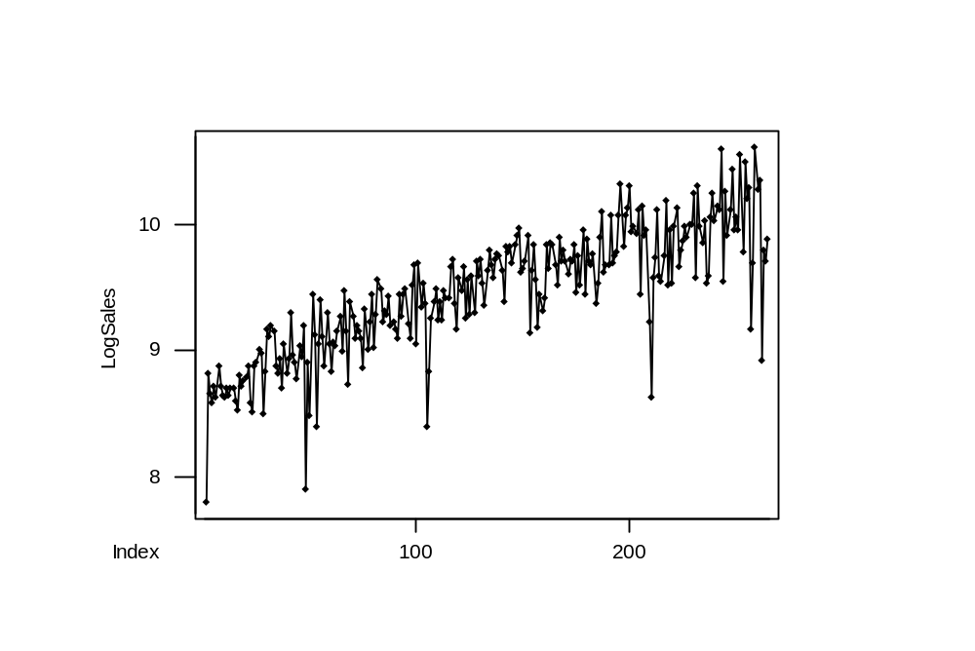
LogSales over time
Checking Assumptions
Copyright © 2005 Brooks/Cole, a division of Thomson Learning, Inc.

Slide 41
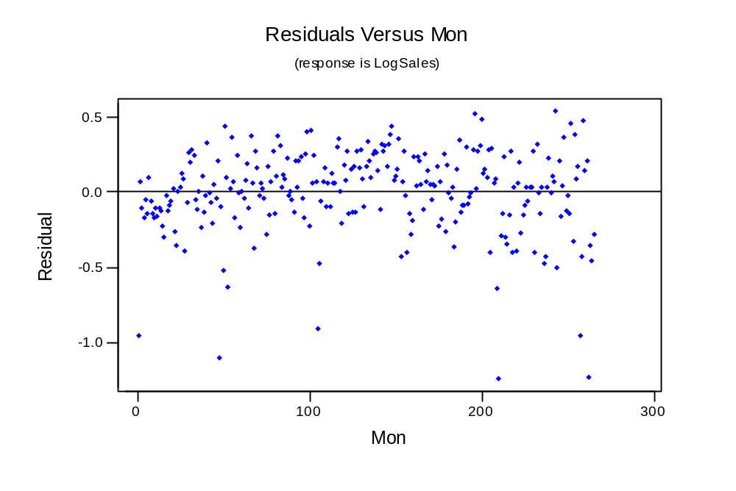
Residuals from Regression
This looks real good after I put this text box on top of those six large outliers.
Checking Assumptions
Copyright © 2005 Brooks/Cole, a division of Thomson Learning, Inc.

Slide 42
6.6 Assessing the Assumption That the Disturbances are Normally Distributed
There are many tools available to check the assumption that the disturbances are normally distributed.
If the assumption holds, the standardized residuals should behave like they came from a standard normal distribution.
  about 68% between -1 and +1
  about 95% between -2 and +2
  about 99% between -3 and +3
Checking Assumptions
Copyright © 2005 Brooks/Cole, a division of Thomson Learning, Inc.

Slide 43
6.6.1 Using Plots to Assess Normality
You can plot the standardized residuals versus fitted values and count how many are beyond -2 and +2; about 1 in 20 would be the usual case.
Minitab will do this for you if ask it to check for unusual observations (those flagged by an R have a standardized residual beyond ±2.
Checking Assumptions
Copyright © 2005 Brooks/Cole, a division of Thomson Learning, Inc.

Slide 44
Other tools
Use a Normal Probability plot to test for normality.
Use a histogram (perhaps with a superimposed normal curve) to look at shape.
Use a Boxplot for outlier detection. It will show all outliers with an *.
Checking Assumptions
Copyright © 2005 Brooks/Cole, a division of Thomson Learning, Inc.

Slide 45
Example 6.5 Communication Nodes
Data in COMNODE6
n = 14 communication networks
Y = Cost
X₁ = Number of ports
X₂ = Bandwidth
Checking Assumptions
Copyright © 2005 Brooks/Cole, a division of Thomson Learning, Inc.

Slide 46
Regression with unusuals flagged
The regression equation is
COST = 17086 + 469 NUMPORTS + 81.1 BANDWIDTH
Predictor Coef SE Coef T P
Constant 17086 1865 9.16 0.000
NUMPORTS 469.03 66.98 7.00 0.000
BANDWIDT 81.07 21.65 3.74 0.003
S = 2983 R-Sq = 95.0% R-Sq(adj) = 94.1%
Analysis of Variance
(deleted)
Unusual Observations
Obs NUMPORTS COST Fit SE Fit Residual St Resid
1 68.0 52388 53682 2532 -1294 -0.82 X
10 24.0 23444 29153 1273 -5709 -2.12R
R denotes an observation with a large standardized residual
X denotes an observation whose X value gives it large influence.
Checking Assumptions
Copyright © 2005 Brooks/Cole, a division of Thomson Learning, Inc.

Slide 47
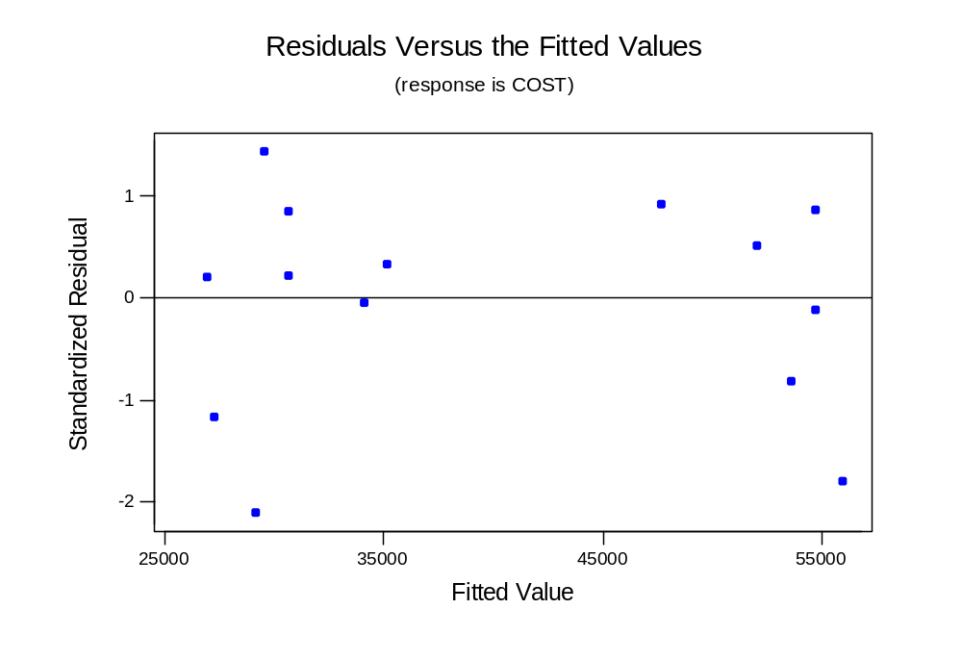
Residuals versus fits (from regression graphs)
Checking Assumptions
Copyright © 2005 Brooks/Cole, a division of Thomson Learning, Inc.

Slide 48
6.6.2 Tests for normality
There are several formal tests for the hypothesis that the disturbances e_{i} are normal versus nonnormal.
These are often accompanied by graphs* which are scaled so that data which are normally-distributed appear in a straight line.
* Your Minitab output may appear a little different depending on whether you have the student or professional version, and which release you have.
Checking Assumptions
Copyright © 2005 Brooks/Cole, a division of Thomson Learning, Inc.

Slide 49
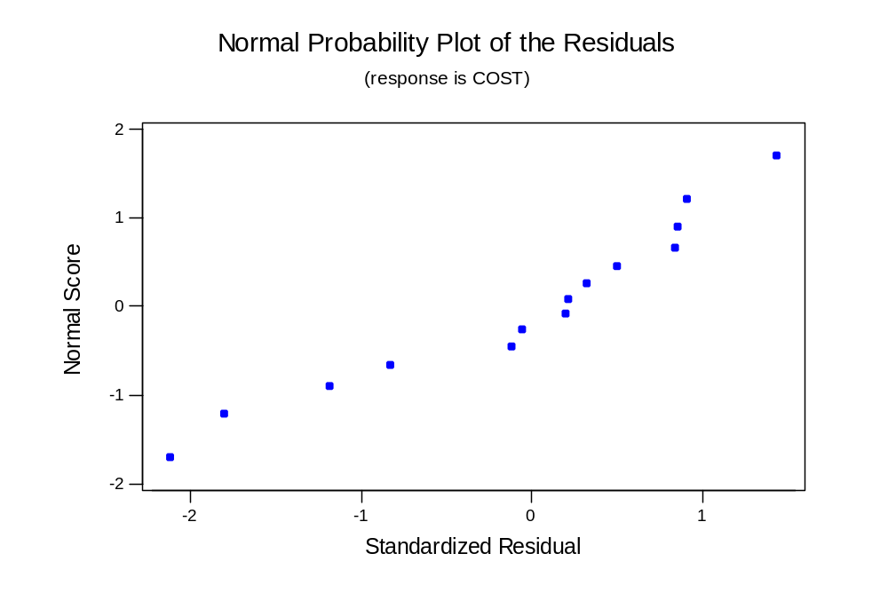
Normal plot (from regression graphs)
If normal, should follow straight line
Checking Assumptions
Copyright © 2005 Brooks/Cole, a division of Thomson Learning, Inc.

Slide 50
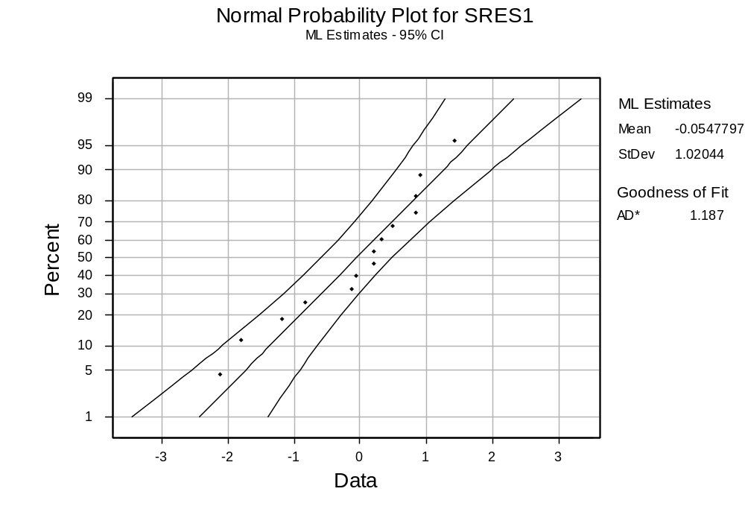
Normal probability plot (graph menu)
Checking Assumptions
Copyright © 2005 Brooks/Cole, a division of Thomson Learning, Inc.

Slide 51
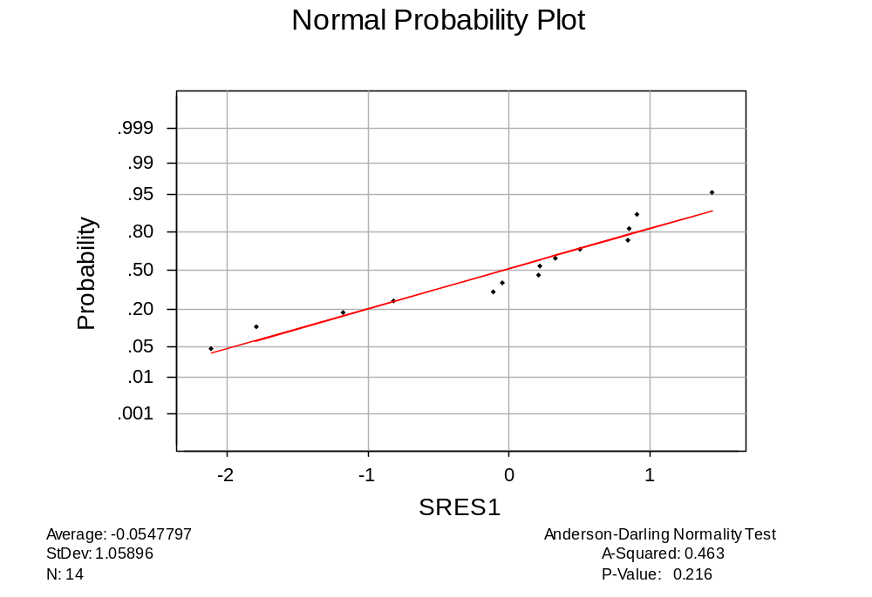
Test for Normality (Basic Statistics Menu)
Accepts
H_{o}: Normality
Checking Assumptions
Copyright © 2005 Brooks/Cole, a division of Thomson Learning, Inc.

Slide 52
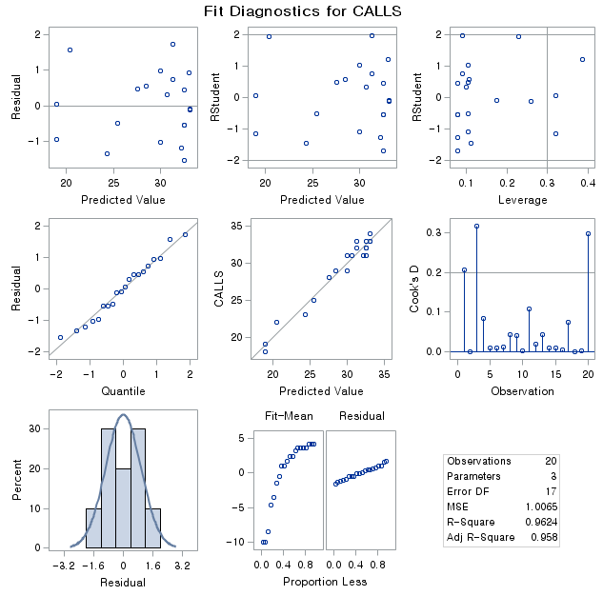
Checking Assumptions
Copyright © 2005 Brooks/Cole, a division of Thomson Learning, Inc.

Slide 53
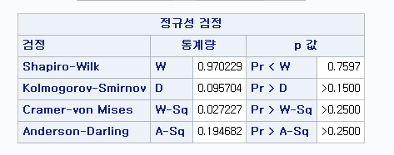
proc reg data = a; model calls = months monsq ; output out=res_out r=res ; run; proc univariate data=res_out normal ; var res ; run;
H0 : Normal Distribution
Checking Assumptions
Copyright © 2005 Brooks/Cole, a division of Thomson Learning, Inc.

